Slide 1
Big Data Analytics
End Sem Project
Arrun Sivasubramanian (AIE 19013)
Prashanth VR (AIE 19047)

Slide 2
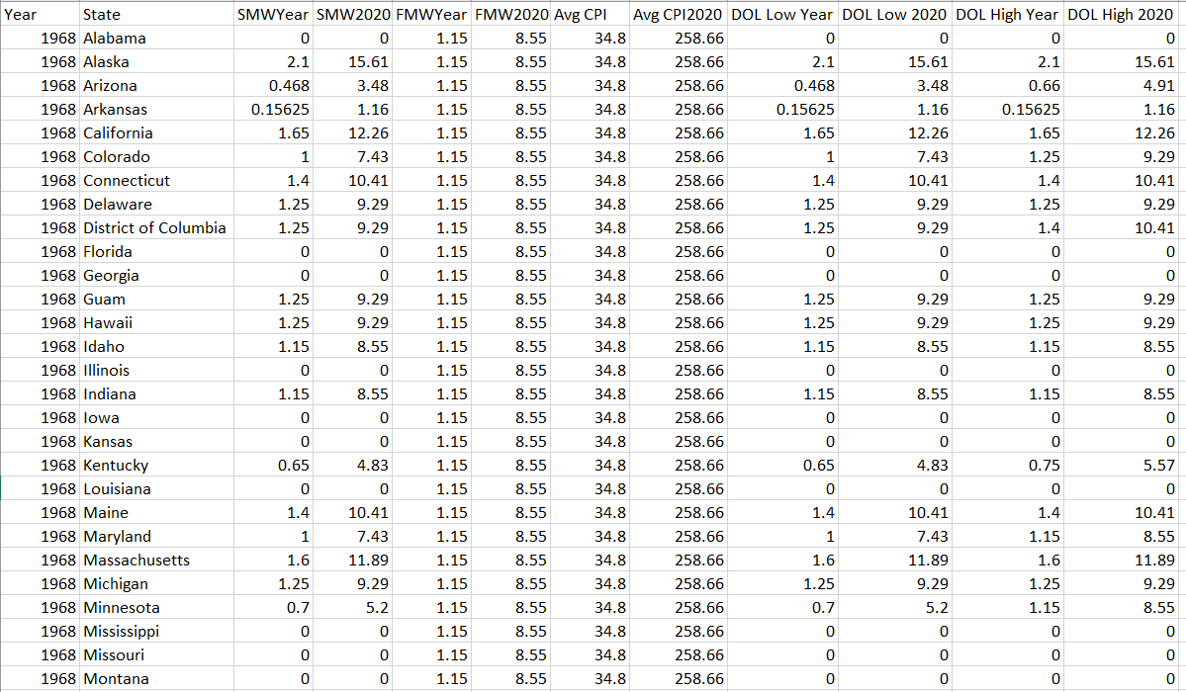
The Dataset :

Slide 3
Prerequisites
00
How to set up the base for Analysis with Spark

Slide 4
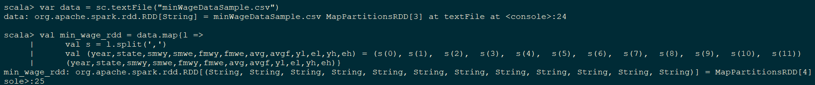
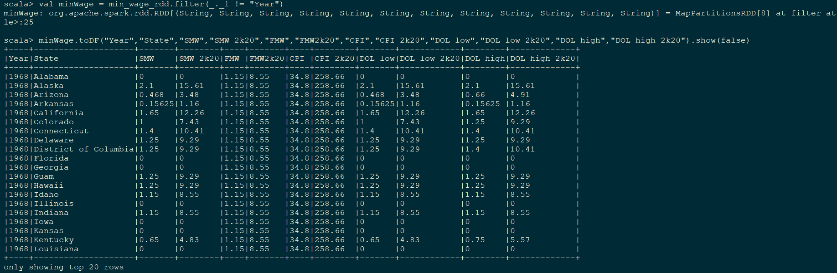
Opening the CSV and storing as RDD:

Slide 5
Time Series Analysis
01
Doing time series analysis for SMW of each state from 1968 to 2020

Slide 6
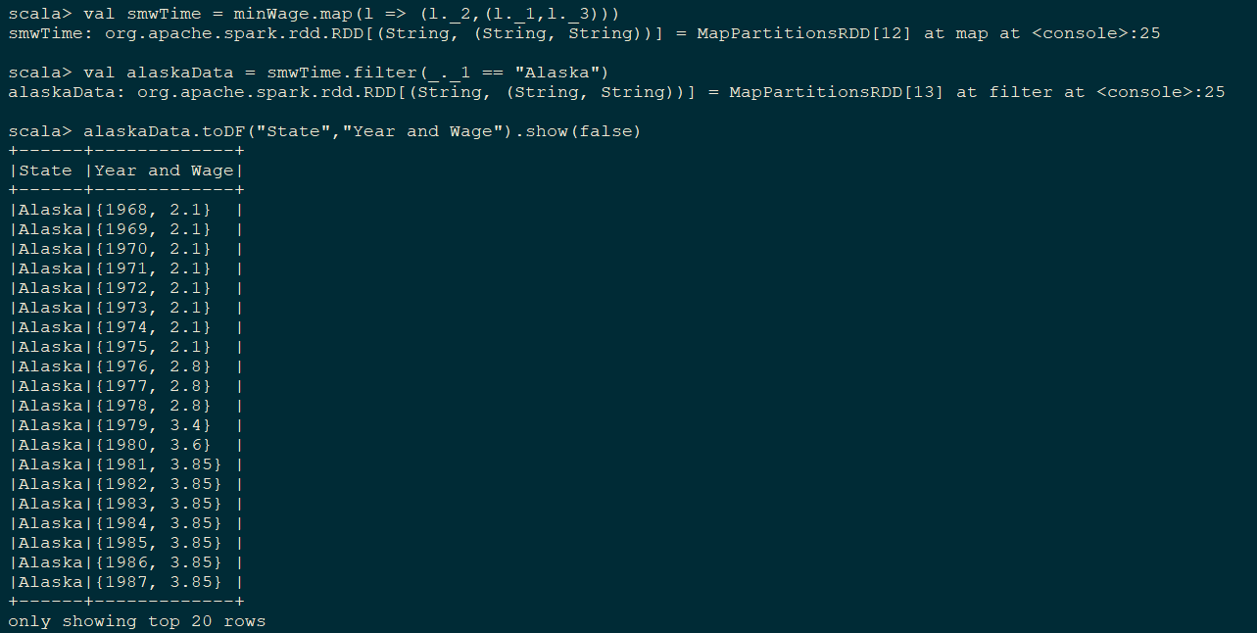
Using SMW from minWageData
Since the data is year wise data, we will have 53 key value pairs corresponding to each state

Slide 7
Find mean SMW for all States from 1968 to 2020
02

Slide 8
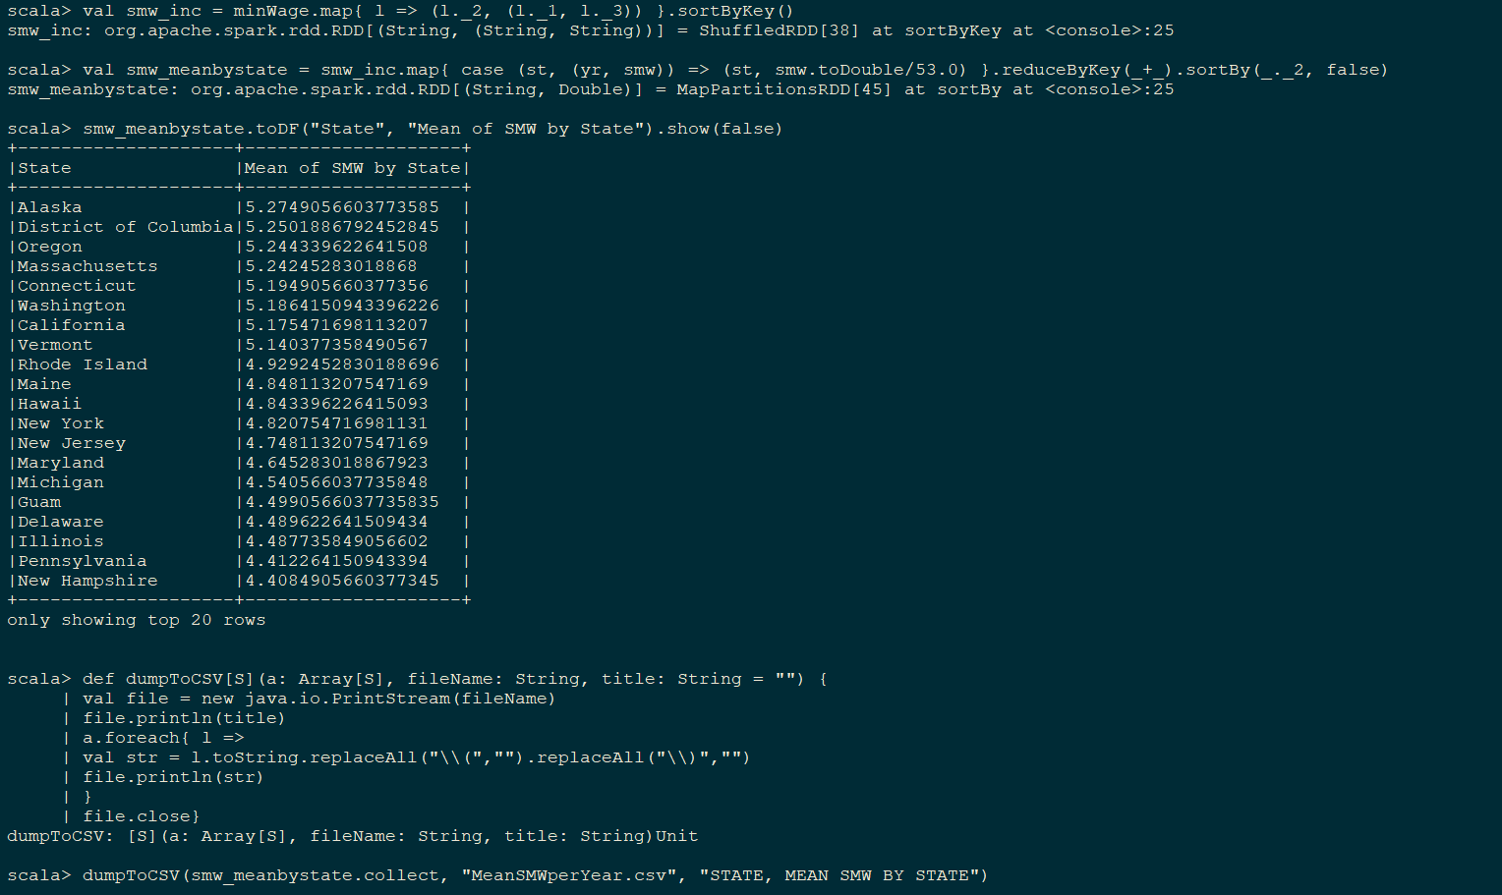
Methodology:

Slide 9
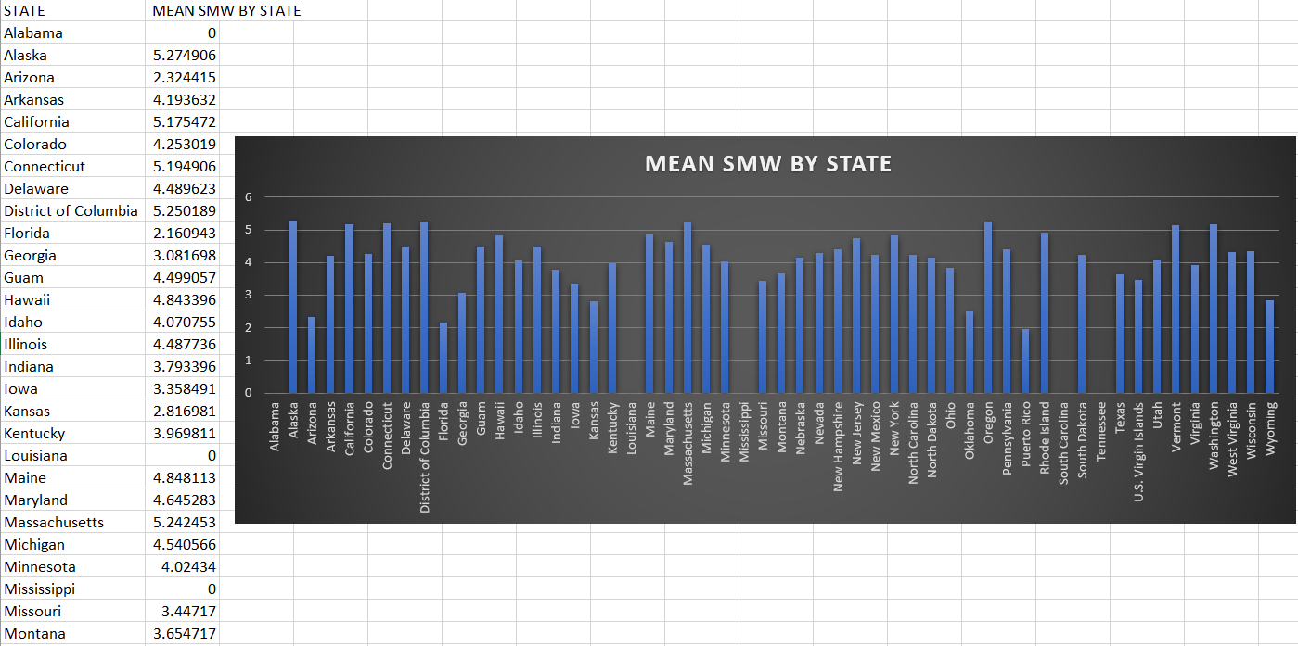
After Dumping!

Slide 10
Find state having max SMW for all years
03

Slide 11
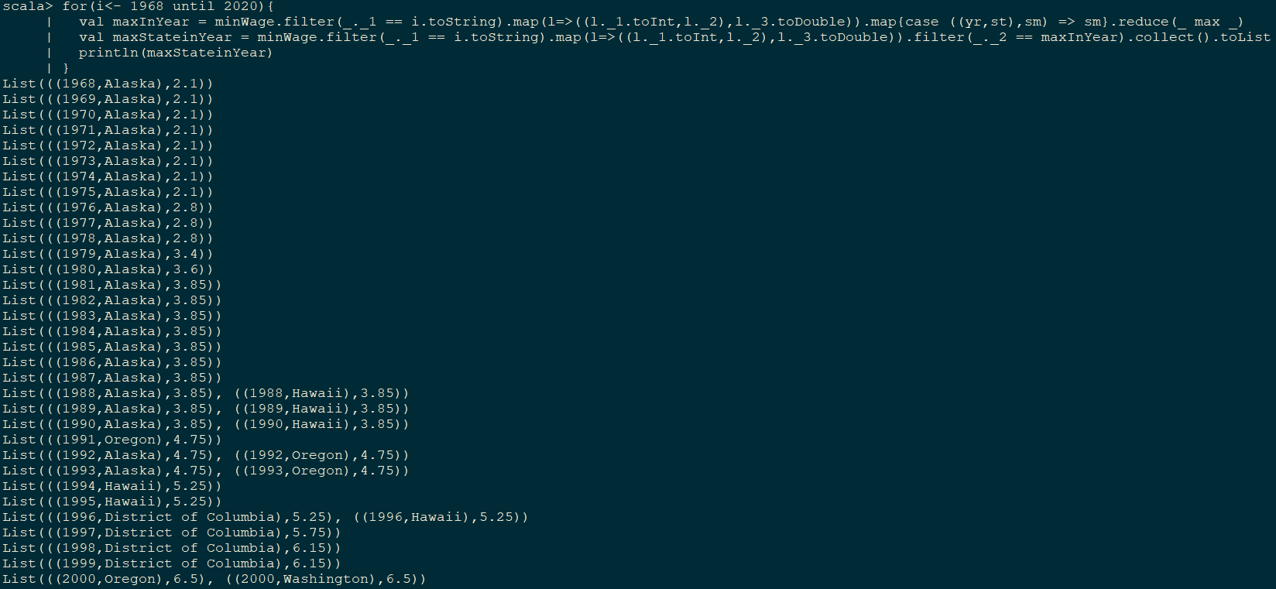
Methodology:

Slide 12
04
Compare SMW and FMW year by year for a given state

Slide 13
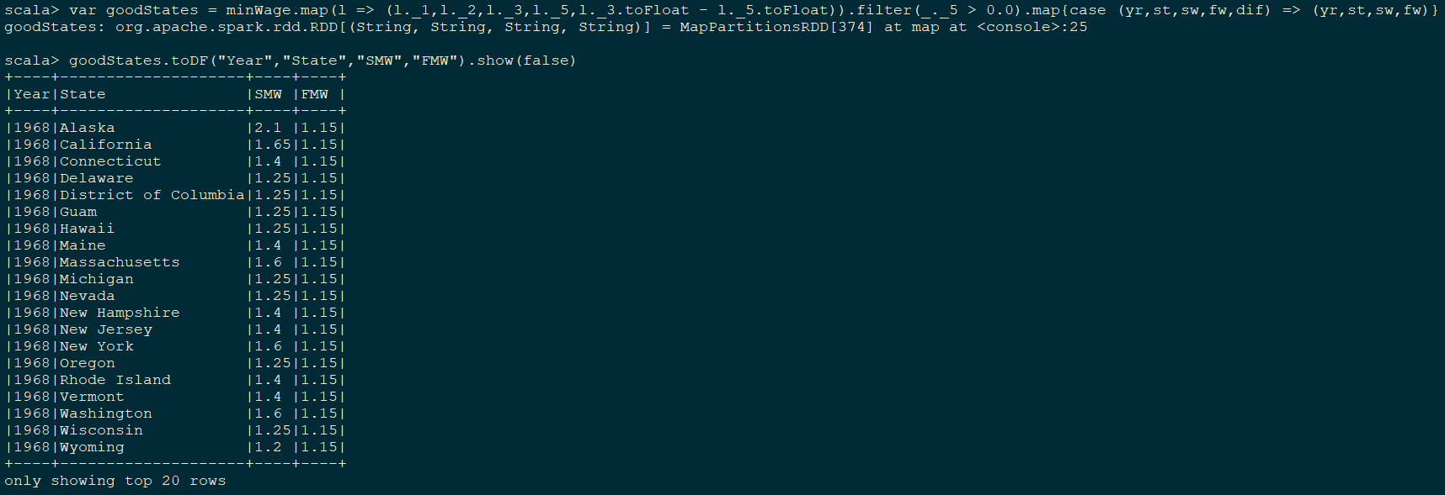
Procedure for SMW>FMW

Slide 14
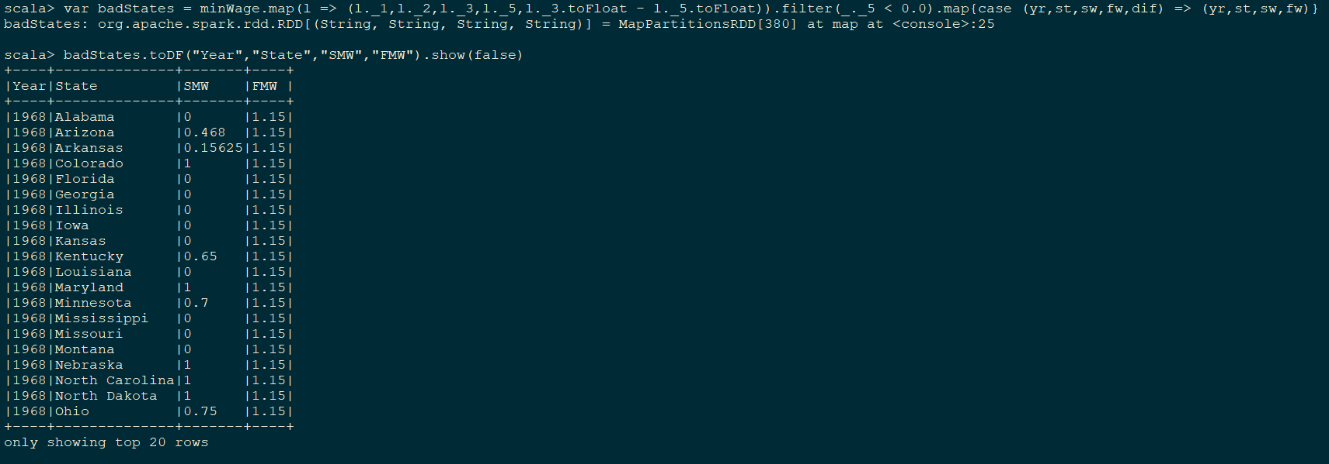
Procedure for SMW<FMW

Slide 15
05
Calculate Federal Minimum wage year By Year

Slide 16
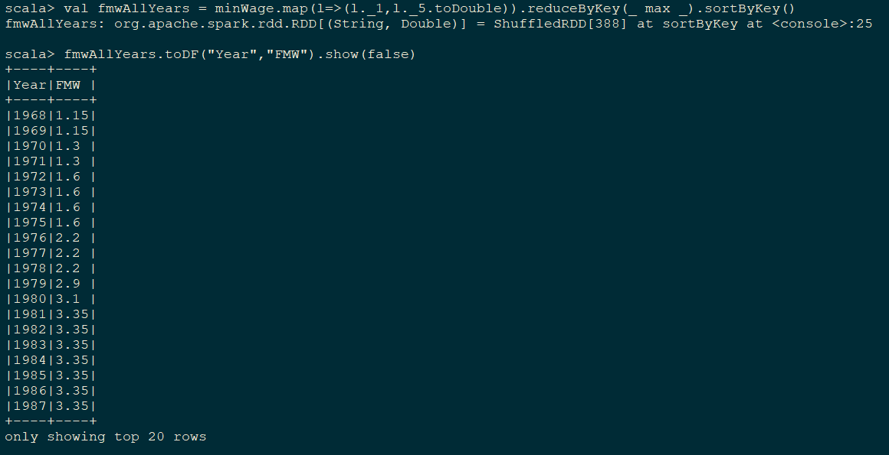
How?

Slide 17
06
Coming to Actual Economics

Slide 18
Compute Effective Minimum wage and inflation based EMW by finding maximum of SMW and FMW for all states for all years

Slide 19
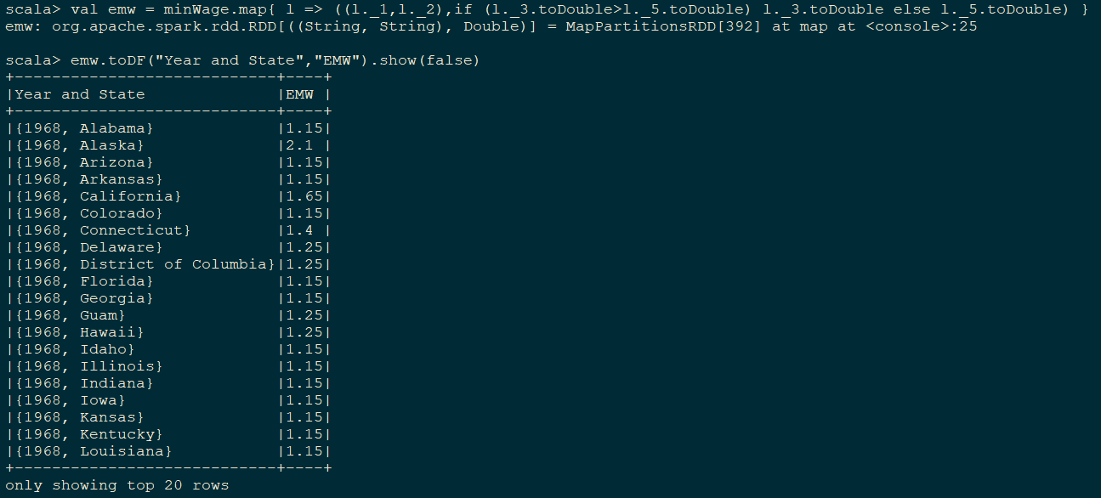
1. Calculate EMW using SMW and FMW

Slide 20
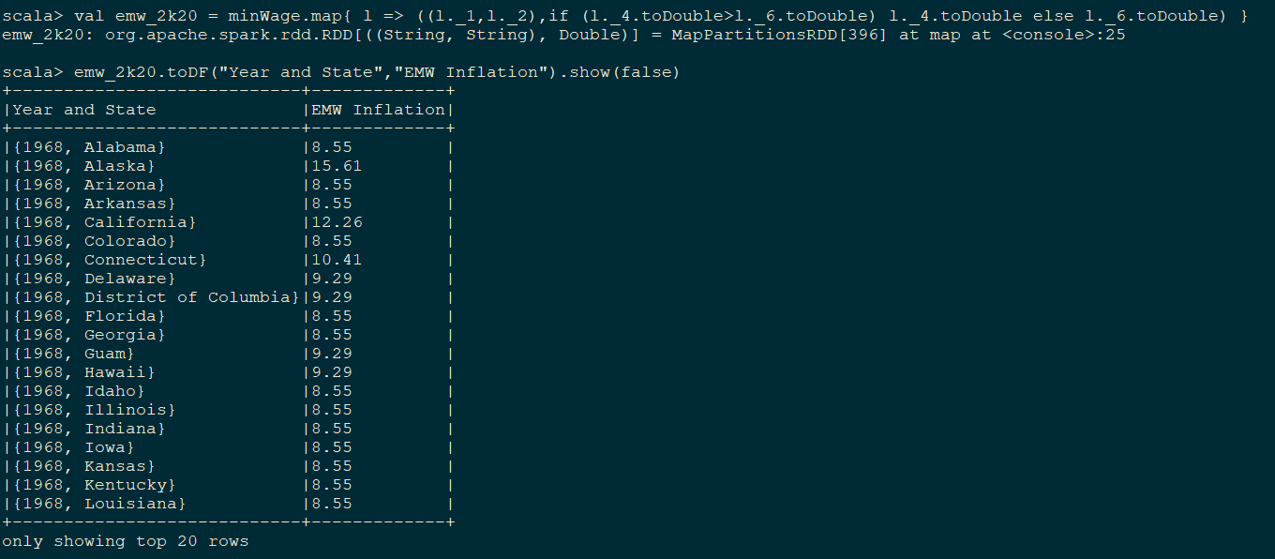
2. Calculate EMW using same procedure for 2k20

Slide 21
07
Computing inflation % change between a year and 2020

Slide 22
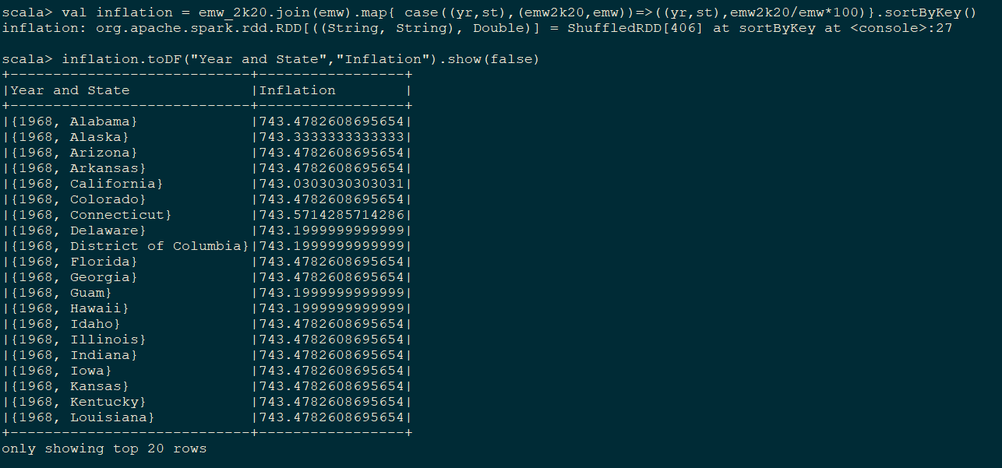
Procedure to Calculate:

Slide 23
Find states which don't meet change in EMW to change in percent CPI
08
To notify if inflation need is not being met

Slide 24
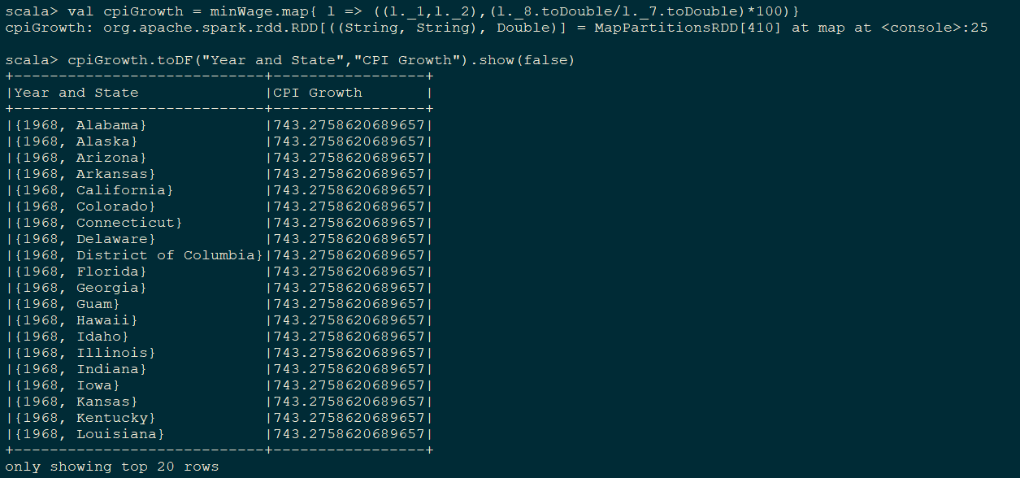
Step 1: Finding CPI growth

Slide 25
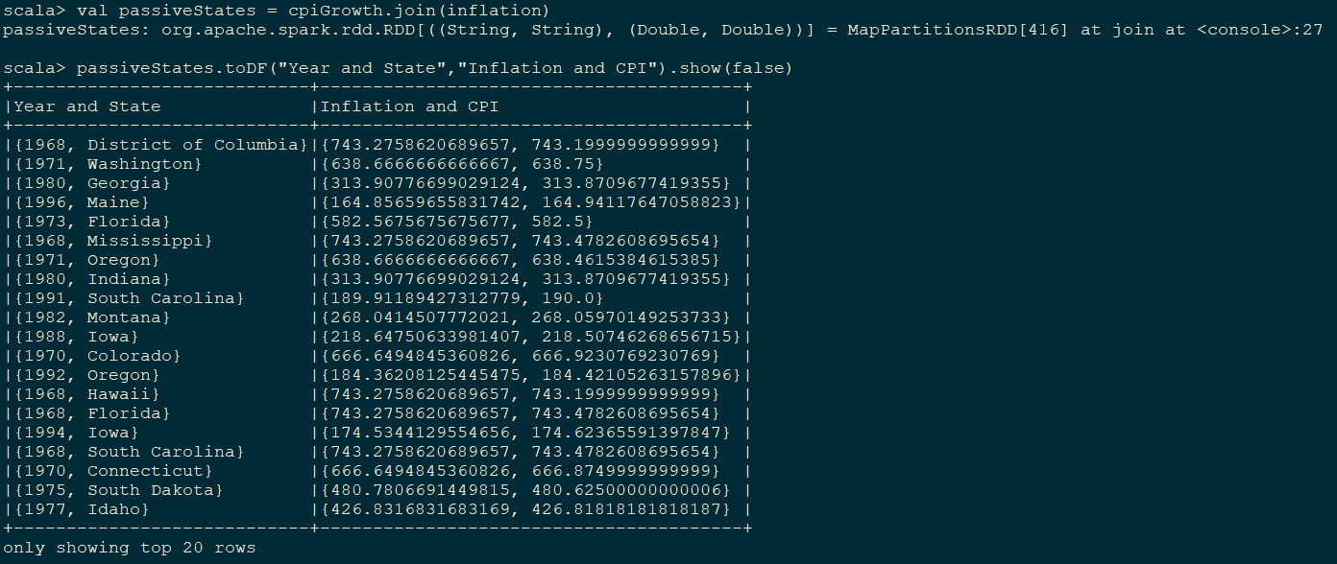
Step 2: Join CPI and Inflation RDD

Slide 26
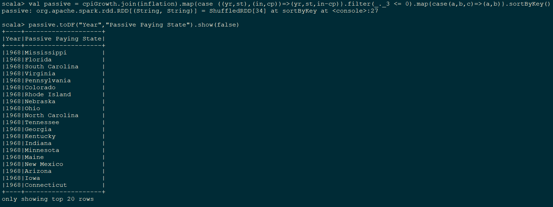
Step 3: Find the Passive Payers

Slide 27
Verifying information with DOL
09
It’s always good to verify informations with source data

Slide 28
Find if a given state had two or more different min wages

Slide 29
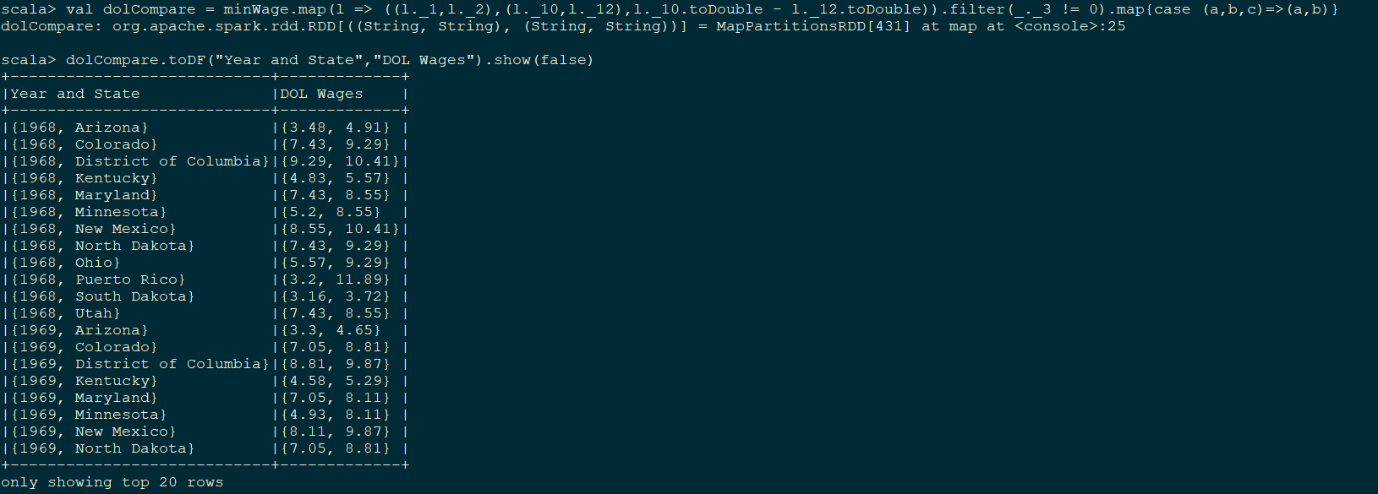
How to find?

Slide 30
Compare DOL Low and DOL low 2k20
10

Slide 31
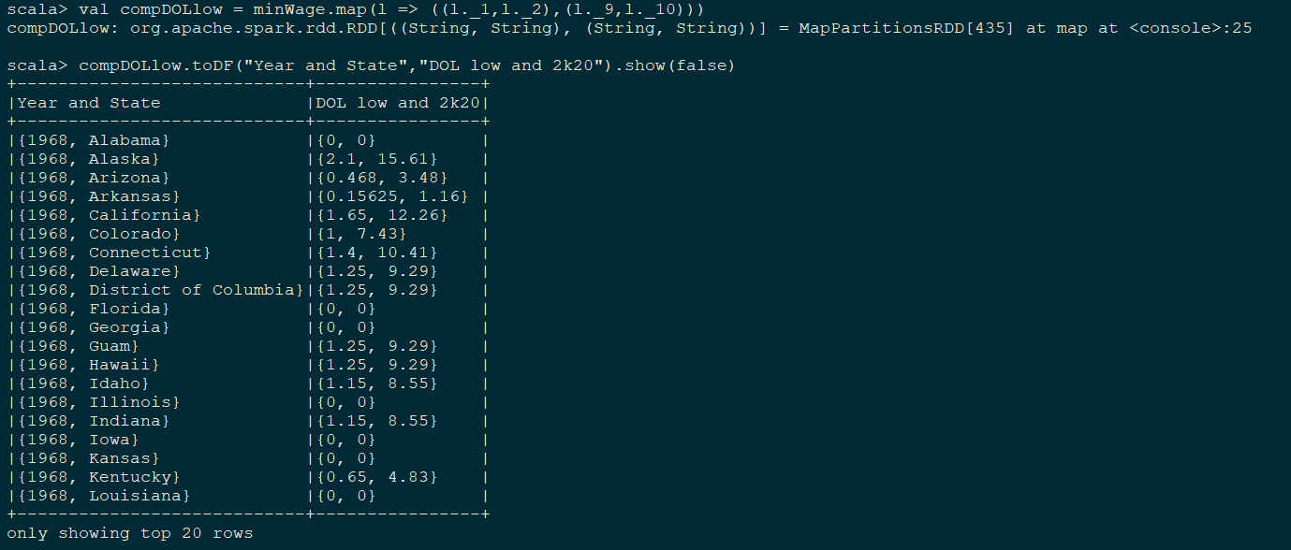
How to find?

Slide 32
Compare DOL High and DOL High 2k20
11

Slide 33
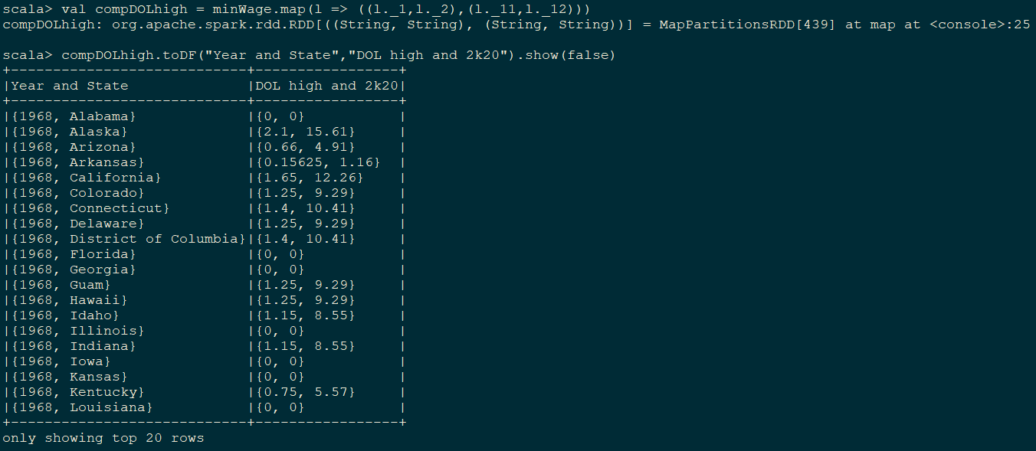
How to find?

Slide 34
Thank
You!

